Slide 1
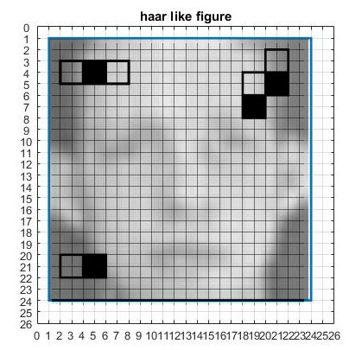

VIOLA AND JONES ADABOOST OBJECT DETECTION
ADVANCED COMPUTER VISION
Design and implementation of a boosting technique for object identification
Máster en
Automática y Robótica
José Ramón Raindo Portillo

Slide 2
INDEX
Introduction - Haar-like features - Integral Images - Classification - AdaBoost - Results - Conclusions
INTRODUCTION
THE ALGORITHM
Haar-like features Integral Images
Classification AdaBoost
RESULTS
CONCLUSIONS

Slide 3
INTRODUCTION
Introduction - Haar-like features - Integral Images - Classification - AdaBoost - Results - Conclusions
VIOLA AND JONES ALGORITHM
Big development in the last decade
Used in all kind of devices and media cameras, cellphones, websites
Viola and Jones AdaBoost object recognition algorithm
Fast – (0.7s 10 years ago computers)
Low false positive rate
Designed for faces, but can be used with all kind of objects

Slide 4
INTRODUCTION
Introduction - Haar-like features - Integral Images - Classification - AdaBoost - Results - Conclusions
OBJECT RECOGNITION
Must be trained
It is composed by 3 stages
TRAINING
Feature extraction
We extract all the possible Haar-Like features from a 24x24 window

Slide 5
INTRODUCTION
Introduction - Haar-like features - Integral Images - Classification - AdaBoost - Results - Conclusions
OBJECT RECOGNITION
Must be trained
It is composed by 3 stages
TRAINING
Feature extraction
Using the Haar-like features, weak classifiers are created
Weak classifiers creation

Slide 6
INTRODUCTION
Introduction - Haar-like features - Integral Images - Classification - AdaBoost - Results - Conclusions
OBJECT RECOGNITION
Must be trained
It is composed by 3 stages
TRAINING
Feature extraction
Using a boosting algorithm we select a set of weak classifiers
Weak classifiers creation
Selection of a set of weak classifiers

Slide 7
INTRODUCTION
Introduction - Haar-like features - Integral Images - Classification - AdaBoost - Results - Conclusions
OBJECT RECOGNITION
Must be trained
It is composed by 3 stages
TRAINING
Feature extraction
STRONG
CLASSIFIER
Weak classifiers creation
Selection of a set of weak classifiers

Slide 8
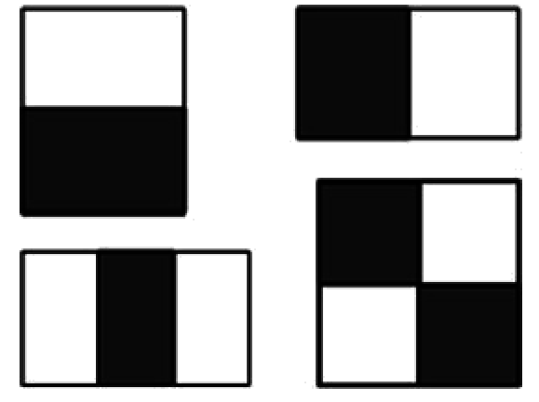
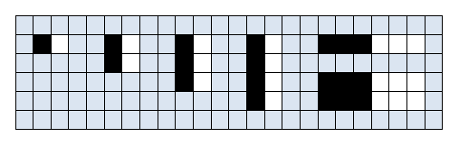
HAAR-LIKE FEATURES
Introduction - Haar-like features - Integral Images - Classification - AdaBoost - Results - Conclusions
Set of positive and negative features
Based in Haar-like figures (black and white squares) inside a 24x24 window:
A lot of combinations (58140)

Slide 9
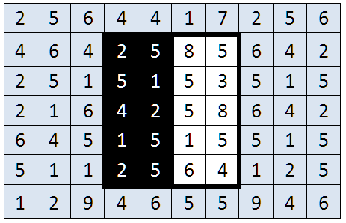
HAAR-LIKE FEATURES
Introduction - Haar-like features - Integral Images - Classification - AdaBoost - Results - Conclusions
10x7 window
The squares represent an operation with the luminance inside an image (the window)
Black part: 2+5+5+1+4+2+1+5+2+5=32
value: 50-32=18
White part: 8+5+5+3+5+8+1+5+6+4=50

Slide 10
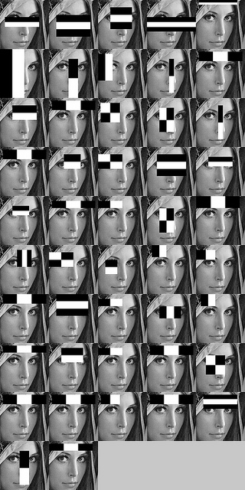
HAAR-LIKE FEATURES
Introduction - Haar-like features - Integral Images - Classification - AdaBoost - Results - Conclusions
There are a lot of combinations!
each combination is a feature
Some limitations can be added:
Size of the window – 24x24 pixels
Limit the size of the Haar-like rectangles (e.g. no smaller than 8x8 pixels)
Number of features (In this project we used only 3 types)
After that, we have 58140 features

Slide 11
HAAR-LIKE FEATURES
Introduction - Haar-like features - Integral Images - Classification - AdaBoost - Results - Conclusions
Simple and fast way to compare features
A lot of features (depend on the window size)
Haar-like value must be calculated for every image and feature
Computationally expensive: O(n)
Important in the boosting part
Training over a large pool of images
Solution: INTEGRAL IMAGES

Slide 12
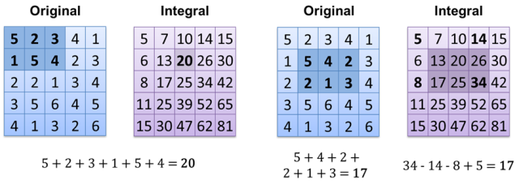
INTEGRAL IMAGES
Introduction - Haar-like features - Integral Images - Classification - AdaBoost - Results - Conclusions
New image based on another image
All pixels are the sum of intensity of the pixels that are above and to the left of it
It is similar to Haar-like assigned number

Slide 13
INTEGRAL IMAGES
Introduction - Haar-like features - Integral Images - Classification - AdaBoost - Results - Conclusions
We can calculate a rectangle in an easy way
Very useful to calculate the Haar-like assigned value!

Slide 14
INTEGRAL IMAGES
Introduction - Haar-like features - Integral Images - Classification - AdaBoost - Results - Conclusions
As many operations as pixels
4 operations ALWAYS
We can calculate a rectangle in an easy way
Very useful to calculate the Haar-like assigned value!

Slide 15
INTEGRAL IMAGES
Introduction - Haar-like features - Integral Images - Classification - AdaBoost - Results - Conclusions
Viola and Jones use integral images instead of images
Can be seen as “catching” – the bulk of operations is done once and reused every time
Can be saved in an easy way

Slide 16
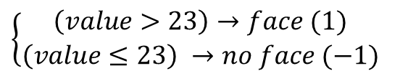
CLASSIFICATION
Introduction - Haar-like features - Integral Images - Classification - AdaBoost - Results - Conclusions
We make a weak classifier from each Haar Like feature
Linear classifier
Compares training set Haar like values and creates threshold
‘α’ defines if faces > threshold or faces < threshold
Marginally better than luck
Threshold
(23)
23 | 24 | 54 | 65 | 334 | 555
← Non faces
Faces →
1 | 3 | 5 | 6 | 23 | 24
Weak classifier:
$$\left\{\begin{aligned}\left(value>23\right)→face (1) \\ \left(value≤23\right) →no face (−1)\end{aligned}\right.$$

Slide 17
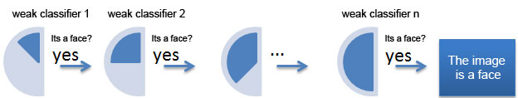
CLASSIFICATION
Introduction - Haar-like features - Integral Images - Classification - AdaBoost - Results - Conclusions
Idea: combine a set of weak classifiers
In sequence (cascade): every weak classifier “votes”
A good set of weak classifiers will create an strong classifier together

Slide 18
ADABOOST
Introduction - Haar-like features - Integral Images - Classification - AdaBoost - Results - Conclusions
Large pool of classifiers: 58.140
Which ones select
Order of smallest error of classification?

Slide 19
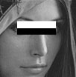
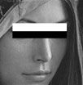
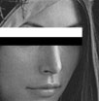
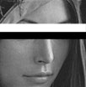
ADABOOST
Introduction - Haar-like features - Integral Images - Classification - AdaBoost - Results - Conclusions
Large pool of classifiers: 58.140
Which ones select
Order of smallest error of classification?
ERROR! It will select similar features!
The resulting classifier wont be better than a weak classifier

Slide 20
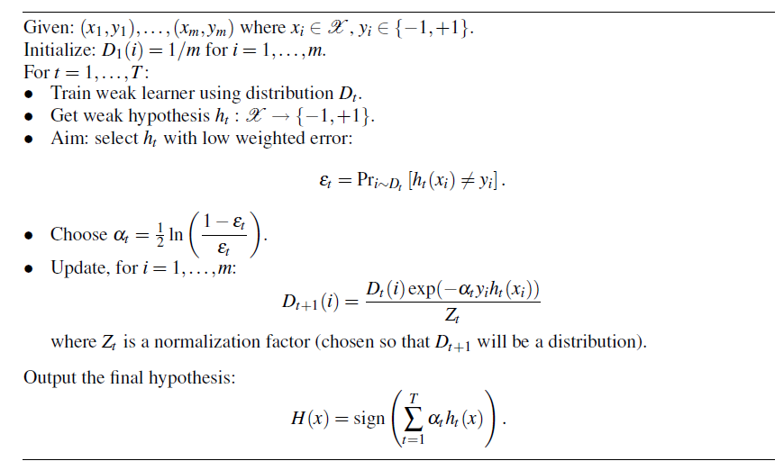
ADABOOST
Introduction - Haar-like features - Integral Images - Classification - AdaBoost - Results - Conclusions
AdaBoost fix this problem by changing the weights
Similar features will have less weight
This forces the next feature to be different
Training set: get values of faces and non faces with associated weights
Find this classifier error
Weight of the classifier
(depends on the error)
Each image weight is modied: if was succesfully identified, will have less importance next time
The strong classifier

Slide 21
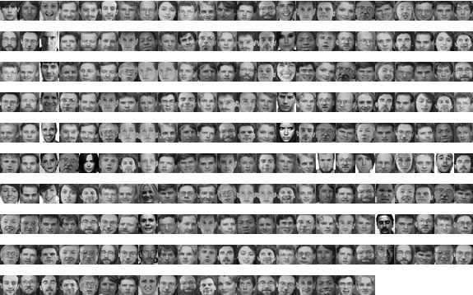
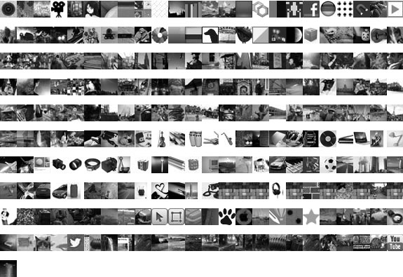
RESULTS
Introduction - Haar-like features - Integral Images - Classification - AdaBoost - Results - Conclusions
Training set: 476 images
Positive set: Faces (235 images)
Negative set: No faces (241 images)

Slide 22
RESULTS
Introduction - Haar-like features - Integral Images - Classification - AdaBoost - Results - Conclusions
The training took 8h 30’ to finish
Hard to debug!
Some classifiers had negative weight (?)
THE MEANING OF NEGATIVE WEIGHT:
Some of the classifiers are very bad (rate success < luck)
Example:
Weak classifier with rate of success of 30% (bad classifier)
Adaboost hypotesis: If we do the OPOSITE - rate of success 70%!!

Slide 23
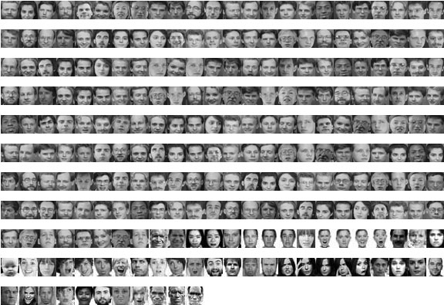
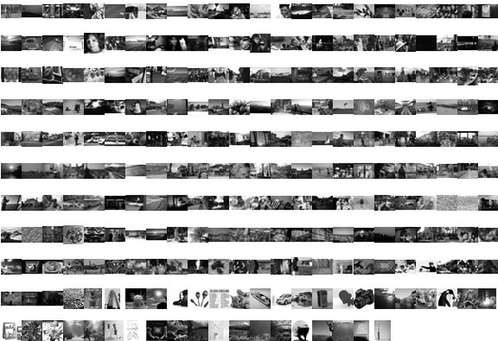
RESULTS
Introduction - Haar-like features - Integral Images - Classification - AdaBoost - Results - Conclusions
Testing set: 510 images
Positive set: Faces (251 images)
Negative set: No faces (259 images)

Slide 24
RESULTS
Introduction - Haar-like features - Integral Images - Classification - AdaBoost - Results - Conclusions
Approach 1:
Select weak classifiers by the weight absolute value

Slide 25
RESULTS
Introduction - Haar-like features - Integral Images - Classification - AdaBoost - Results - Conclusions
Classifier that mix positive and negative weight weak classifiers:
Classification graphic for a 1000 weak classifier strong classifier.
It almost always take that the value is a face
Not a good classifier

Slide 26
RESULTS
Introduction - Haar-like features - Integral Images - Classification - AdaBoost - Results - Conclusions
Classifier that mix positive and negative weight weak classifiers:
It becomes worse the more classifiers used!!
Possible cause:
The classifiers were created to minimize errors
If a classifier has a low rate of success, it means that the values of this feature are too mixed
BAD CLASSIFIER

Slide 27
RESULTS
Introduction - Haar-like features - Integral Images - Classification - AdaBoost - Results - Conclusions
Approach 2:
get only the positive weighted classifiers

Slide 28
RESULTS
Introduction - Haar-like features - Integral Images - Classification - AdaBoost - Results - Conclusions
Strong classifier with only positive weight weak classifiers
Classification graphic for a 1000 weak classifier strong classifier.
Is very good identifying faces!
It finds hard to know when something is not a face

Slide 29
RESULTS
Introduction - Haar-like features - Integral Images - Classification - AdaBoost - Results - Conclusions
Strong classifier with only positive weight weak classifiers
The first weak classifiers
are strong
The grow stops around 70%
After the initial drop, the performance grows
There are a lot of bad classifiers with high weight!
DOES THE STRONG CLASSIFIER WORKS AS THE BEST OF THE WEAK CLASSIFIERS?

Slide 30
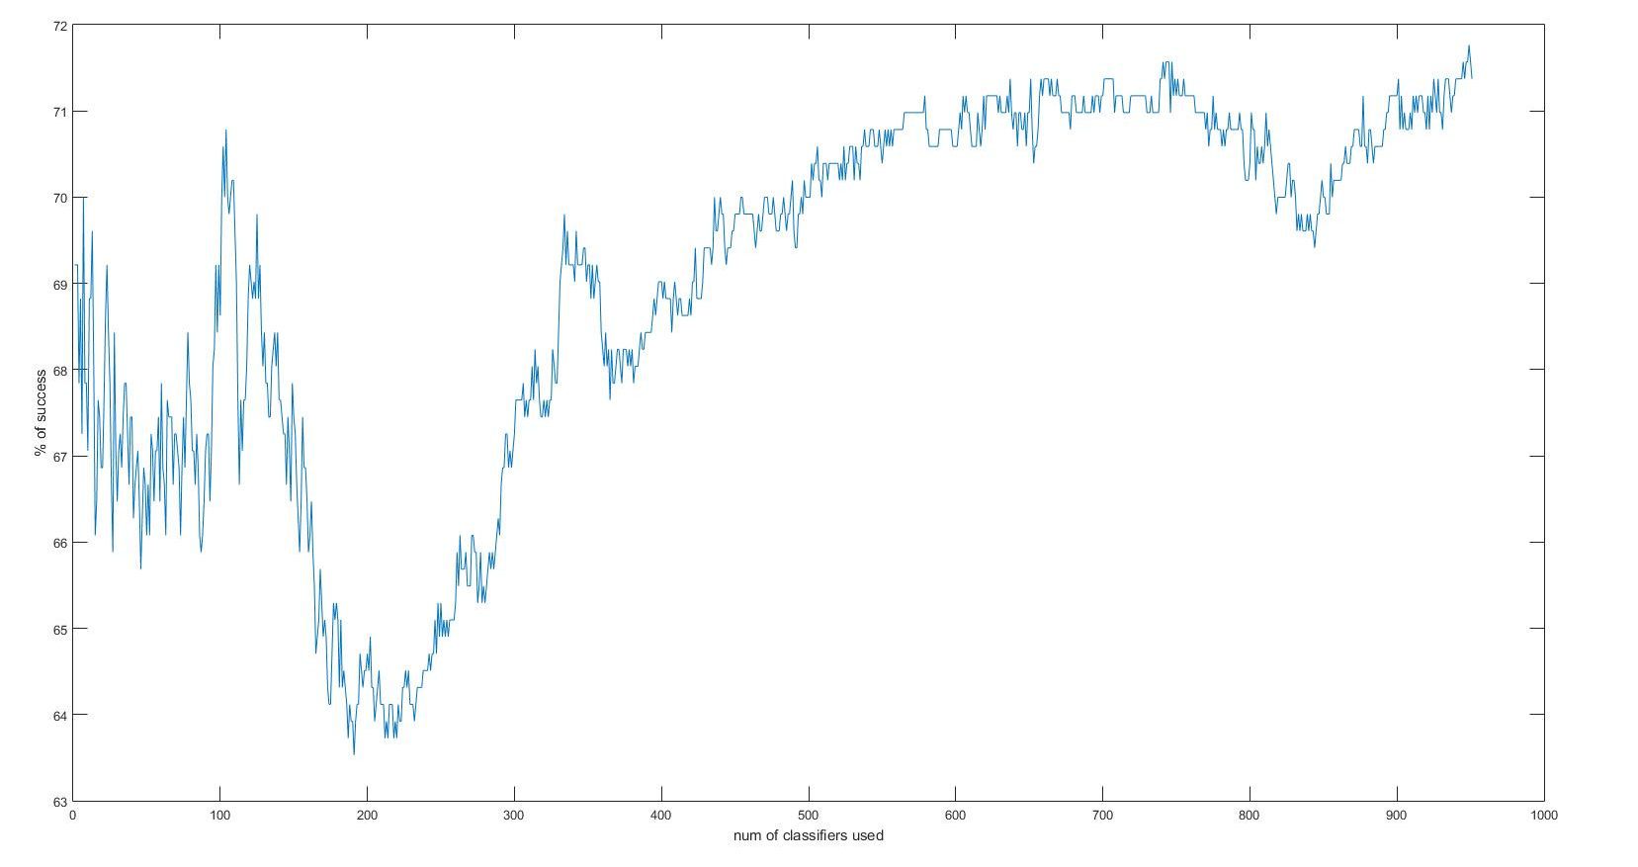
RESULTS
Introduction - Haar-like features - Integral Images - Classification - AdaBoost - Results - Conclusions
result after getting ride of the bad classifiers (1) (by hand)

Slide 31
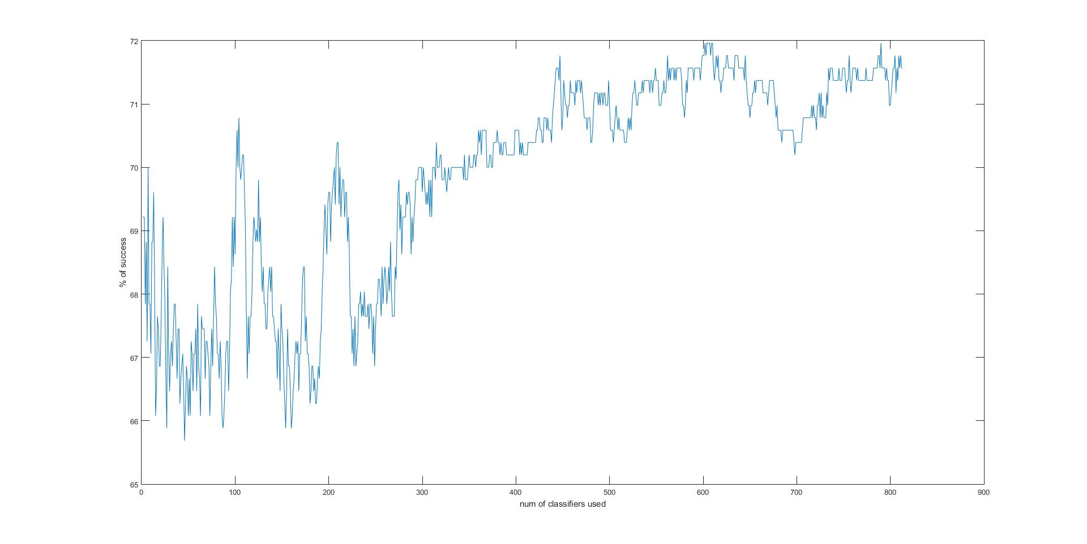
RESULTS
Introduction - Haar-like features - Integral Images - Classification - AdaBoost - Results - Conclusions
result after getting rid of the bad classifiers (2) (by hand)

Slide 32
RESULTS
Introduction - Haar-like features - Integral Images - Classification - AdaBoost - Results - Conclusions
Example of Haar like feature from some of the best weak classifiers

Slide 33
CONCLUSIONS
Introduction - Haar-like features - Integral Images - Classification - AdaBoost - Results - Conclusions
Negative weight weak classifiers aren’t reliable (to much entropic)
Positive weight weak classifiers work but…
Good to identify faces
Confused when identifying non faces
Not all the high weight classifiers were good

Slide 34
CONCLUSIONS
Introduction - Haar-like features - Integral Images - Classification - AdaBoost - Results - Conclusions
How to fix?
Improve the best threshold search
Increase Haar like features types? (> 8 hours training!)
Increase non faces training set? (> 8 hours training!)
Use bigger training set? (> 8 hours training!)
Repeat the learning process iteratively? (> 8 hours training!)
Adaboost gives priority to the first weak classifiers it encounters from the same family! (pattern recognition problem)
Use a different boosting algorithm?

Slide 35
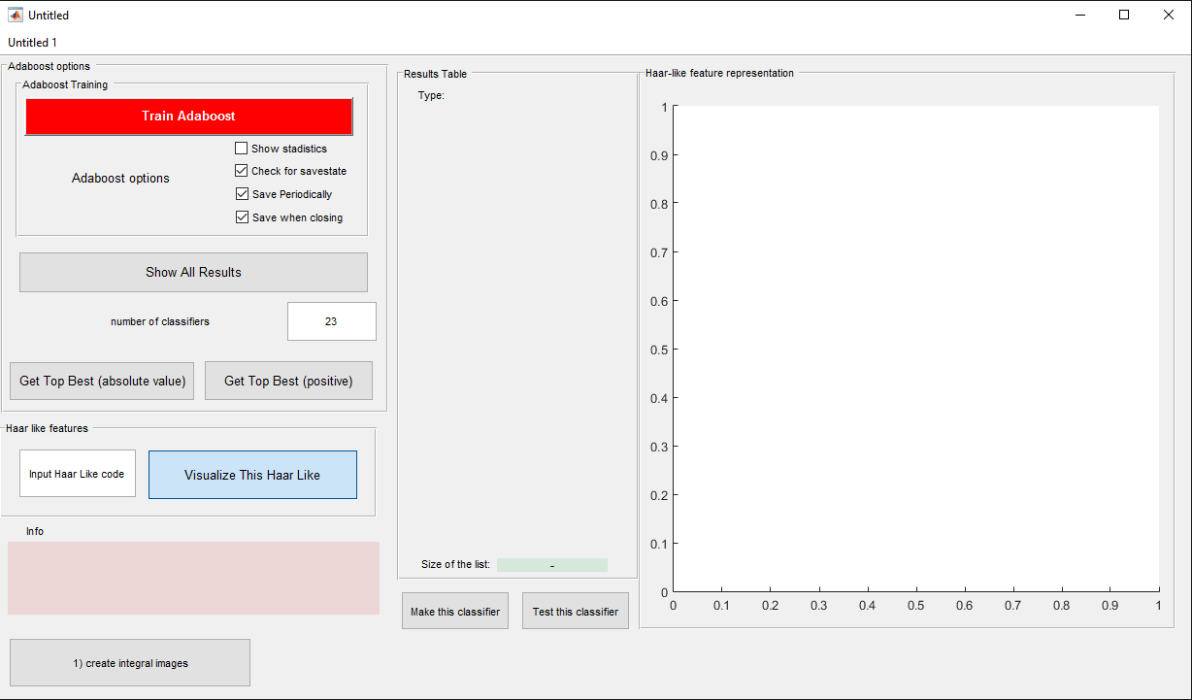
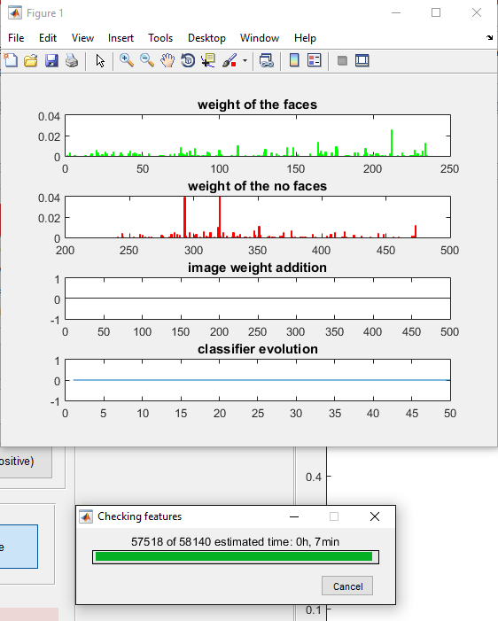
THANK YOU VERY MUCH!

